Slide 2
Food, it's a way of life.
6 areas covered in the syllabus:
Diet and Good Health
Principles of Nutrition
Food Commodities
Science of Food
Food Provenance
Cooking and Food Preparation

Slide 3
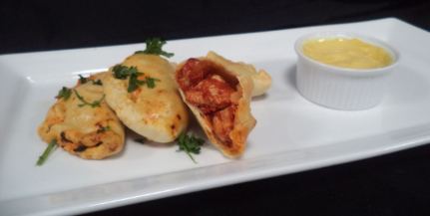
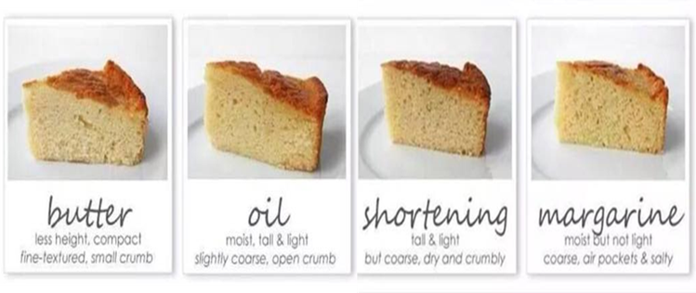
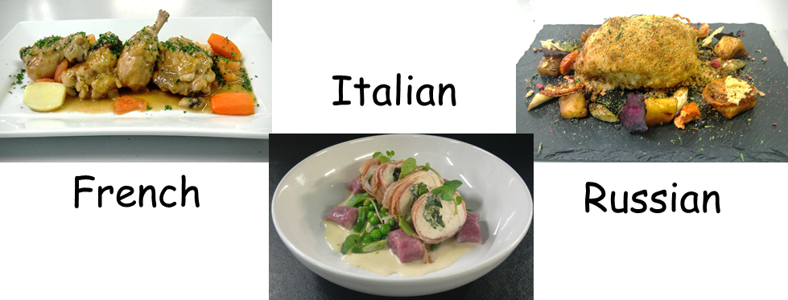
GCSE Food Preparation & Nutrition Grades 1-9 How will I be assessed? Component 1:Principles of food preparation and nutrition Written Examination 50% 1 hour 45 minutes. Component 2 : Food preparation and nutrition in action 50% (NEA1 & NEA2)
Task 1 30 marks (15%) Food Science Investigation 3 hr practical exam & write up e.g. best fat for light airy cake texture | Task 2 70 marks (35%) Food Preparation 3 hr practical exam & write up e.g. 3 cultural dishes made with chicken

Slide 4
Things to consider
Subject not the teacher
You not your friends
Cooking most weeks – need to be reliable with ingredients
Will be theory too – not all cooking
Be prepared to try new foods

Slide 5
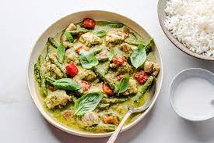
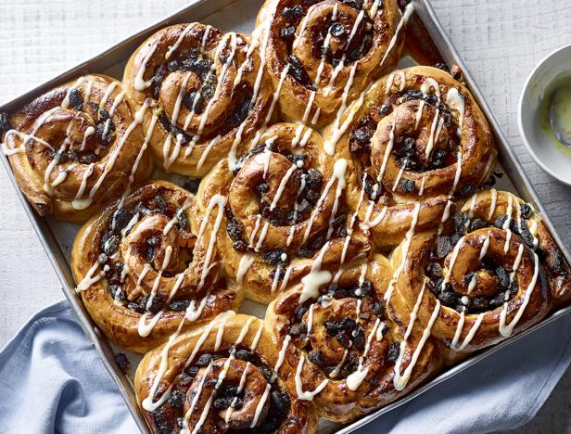
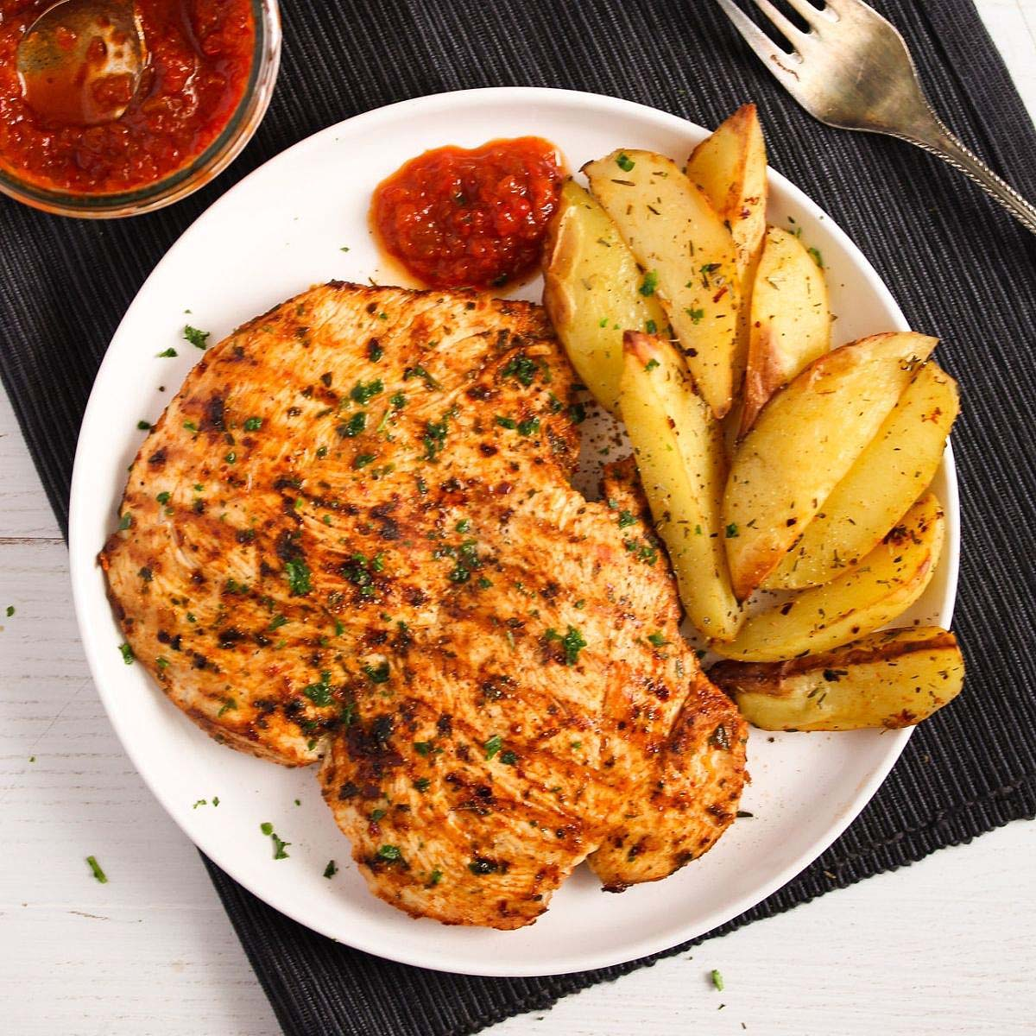
Examples of foods we cook:
Pavlovas
Burgers
Thai green curry
Variety of breads/buns
Profiteroles
Veg curry
Butterfly chicken

Slide 6
Food Futures 16+
6th form colleges | Apprenticeships | Vocational
WJEC Level 3 Food & Nutrition | meat & poultry abattoir worker butcher baker fishmonger, supply chain operator food & drinks engineer brewer advanced dairy technician | food & beverage service professional cookery sustainable commodities baker patisserie butcher food waste management hospitality supervisor confectioner
Degree Level
biomedical engineering BSc nutrition & food science food science & microbiology food science & technology biochemistry with industrial experience food & consumer science food nutrition & well-being herbal medicine (phytotherapy) pharmacology (B210) medicine | international food & agribusiness hotel & event management precision livestock foundation degree human nutrition, animal management sport coaching & exercise science ecology & conservation equine health & nutrition sport health & social welfare

Slide 7
Food Futures Careers
in education
teacher chef lecturer university lecturer
armed forces catering corps
British Army Royal Air Force Navy
hospitality & catering
front of house – concierge, receptionist, maître d’, drinks & beverage manager, sommelier, waiting staff, housekeeping, events manager, mixologist back of house – kitchen porter, commis chef, chef de partie, pastry chef, sous chef, head chef, executive head chef
artisan food producer
baker & patisserie cheesemonger chocolatier & confectioner butcher & charcuterie fishmonger drinks producer preserves & condiments
Agriculture
farmer farm labourer animal nutritionist food producer vineyard manager winemaker engineering geologist environmental scientist soil microbiologist mechanical engineer aquarist ecologist
food science
naturopath food technologist toxicologist microbiologist nutritional therapist product development scientist quality control manager research scientist development chef technical brewer
food & drink manufacturing
manufacturing engineer food compliance quality assurance food purchasing product development product sales marketing & branding production manager development chef

