Slide 2
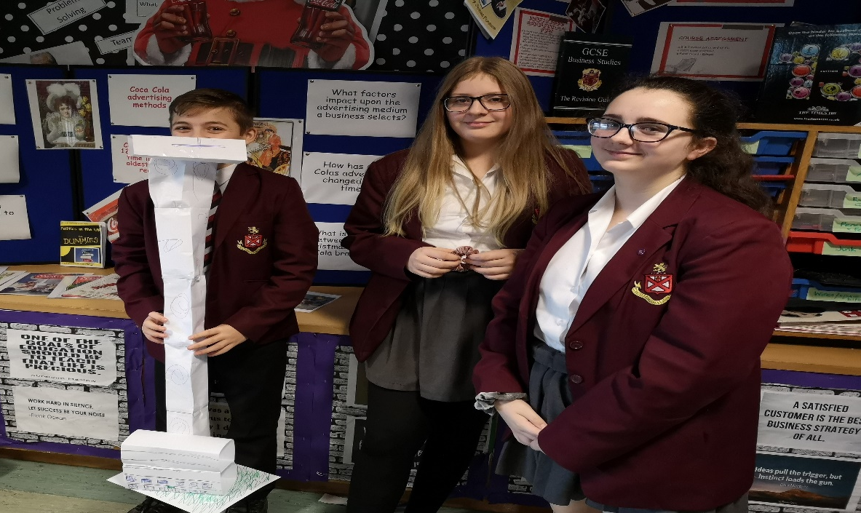
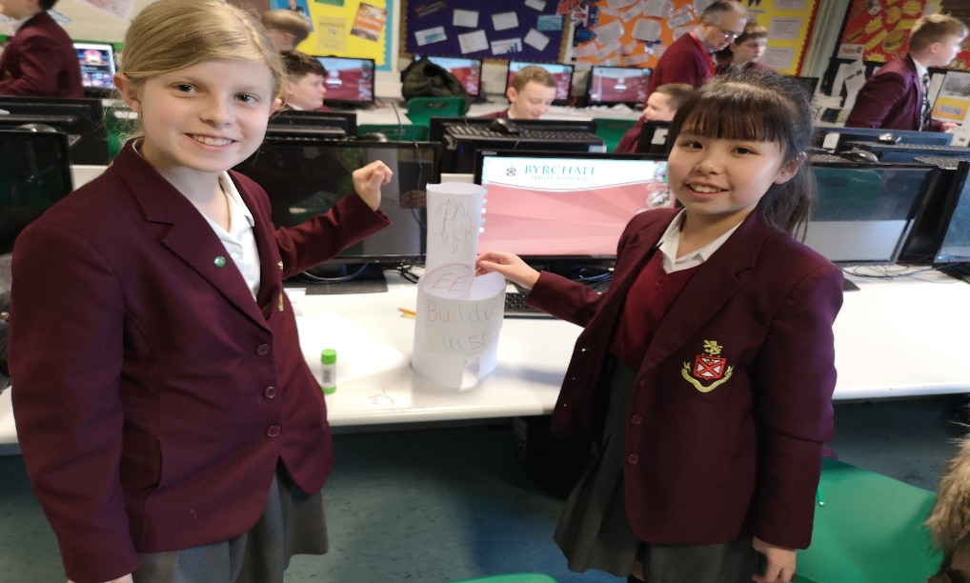
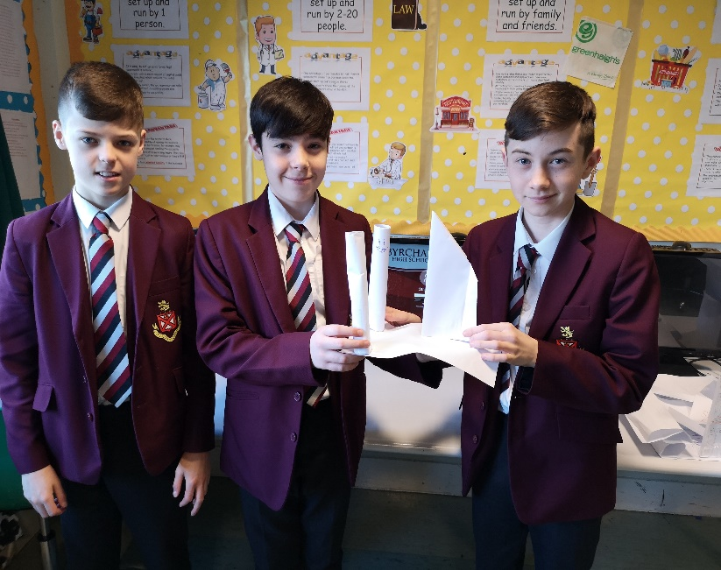
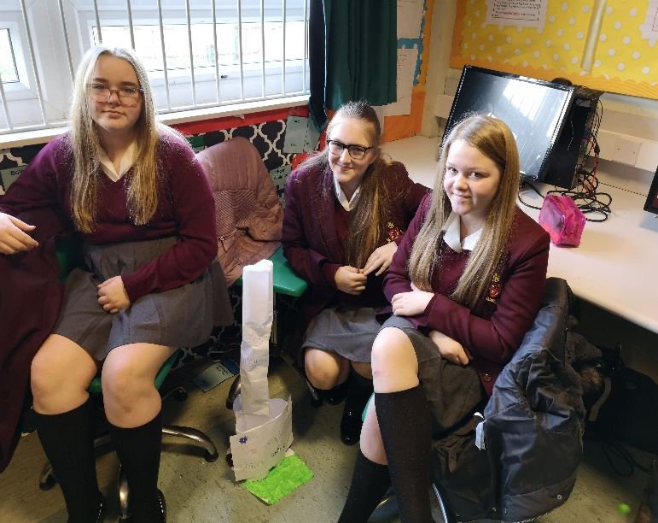
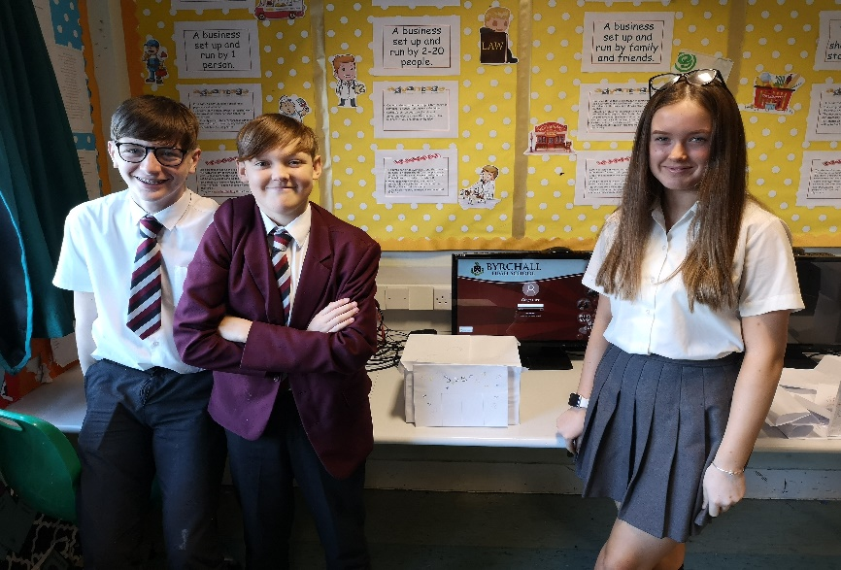
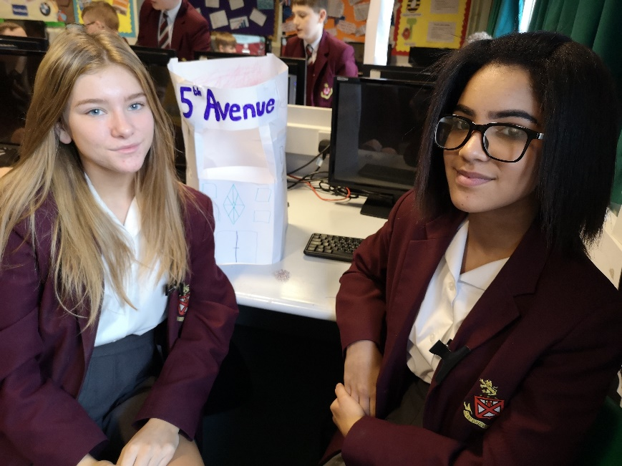
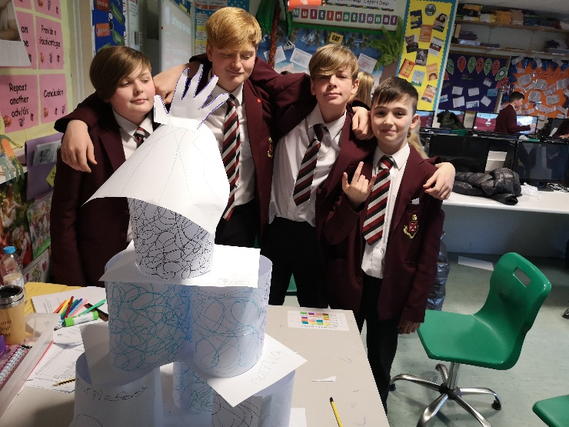
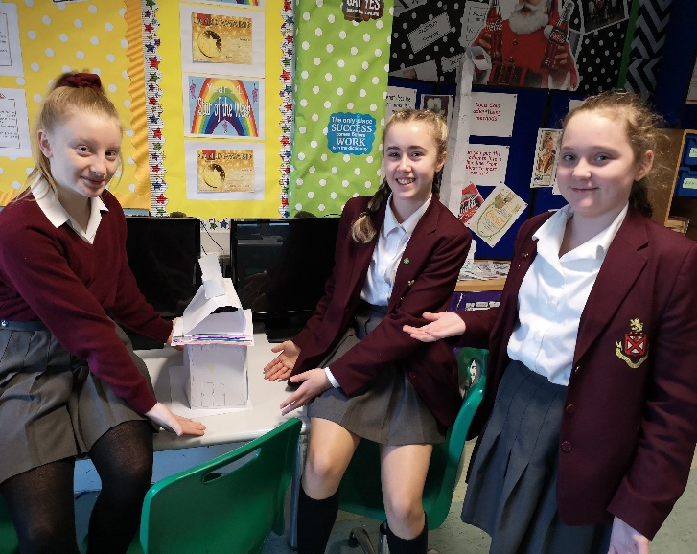
Are YOU the next Lord Sugar?!

Slide 3
WHAT IS BUSINESS STUDIES/ENTERPRISE?
Do you ever stop and think about:
The design process, planning and research that goes into your latest Smart Phone?
The impact that fashion trends have upon the sales and profitability of fads like loom bands/fidget toys.
Why Social Media such as Facebook is such a useful promotional tool from a business perspective?
How advances in technology have led to new product development from Retro Games such as Pac Man to today’s latest Xbox/PlayStation game?
How Branding increases the price of everything you eat or drink?
The impact that celebrity endorsement has upon the prices of products?
All of these decisions are items that must be considered by businesses.

Slide 4
2 options
GCSE Business:
100% exam at end of year 11.
CNAT in Enterprise and marketing
2 large projects – 60%
one exam – 40%

Slide 5
OPTION ONE: GCSE
A lot of
essays
More in depth coverage of a range of business areas
6 theory units
Business activity
Marketing
Production and ICT
Human Resources
Finance and Accounting
External Influences
Need to be confident in maths
2 x exams sat at end
of year 11

Slide 6
OPTION TWO: CNAT ENTERPRISE AND MARKETING
More emphasis on setting up a business and marketing
3 units
1. Enterprise and Marketing exam
one 90 min exam = 40%
2. Designing a business proposal
Use market research to design effective products (past projects have involved fashion and pizza)
3. Marketing and pitching a business proposal
Creating your own brand, range of products, producing a business plan and pitching to external advisors.
1 x exam sat in y11
2 x projects in Y10
Must have good attendance to ensure coursework will be done

Slide 7
Which one is for me?
Neither is an “easy” option but if you have a positive attitude and good work ethic you will do well….
Both require a lot of hard work, awareness of the real world (news), essay writing and a good grasp of maths.
CNAT– project work most lessons – requires organisation/ICT skills/teamwork and communication/presentation skills.
GCSE – more knowledge based/typical style lessons – wider application to the real world.

Slide 8
BENEFITS OF CHOOSING BUSINESS STUDIES AS AN OPTION?
Links directly to the world of work
Lots of cross curricular links
Employers value the qualification
There are real opportunities to progress in education or employment
You will gain valuable, transferable skills
When you leave school and wish to get a job, you will understand more about the way a business runs
If you chose not to become an employee you will have the skills and knowledge to start your own business.

Slide 9
FUTURE CAREER PATHWAYS…
Business Studies opens up your future in terms of both college courses and future jobs!
Accountant
Teacher
Run your own business
Journalism
Police
Advertising/sales
Leisure and Tourism
Retail
Lawyer/solicitor

Slide 10
Hear it direct from Business Students…
Our Business Ambassadors this year are Lexi and Paigan!
Feel free to arrange a meet up with them via Mrs McGuire if you want to speak to current Business students!

Slide 11
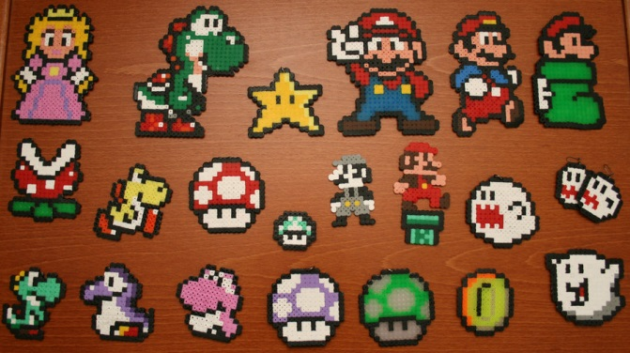
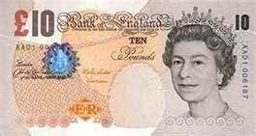
EXTRA CURRICULAR CLUBS (1)
Hama Beading club – One lunchtime a week students create a variety of key rings, coasters, badges, jewellery and door signs made from Hama Beads. Students learn how to carry out basic market research and produce products in line with customer demand. Products are sold to raise money for a variety of charities.
Make Your Mark with a Tenner – This is a national competition whereby students who participate each receive £!0 funding. Students have one month working either on their own or in small teams to turn their £10 into as much money as possible. The original £10 must be returned and 50% of profits made donated to the schools charity. The remaining 50% of profit can be kept by students.

Slide 12
EXTRA CURRICULAR CLUBS (2)
Peter Jones National Challenge – students work in small teams to set up their own mini business during the Autumn term. Teams must put together an initial business plan and submit their plan online prior to funding being awarded. Teams keep an online blog of the products and profit margins with a regional winner in each area for most profit made.
Barclays Bank Money Hero’s competition – the school participates in the annual money hero’s challenge which involves coming up with an initiative to encourage young people to save money rather than spend. In 2012 Byrchall students came in first place and won £3000 which was invested into new technologies within the school.
Papworth Trust Charity programme – the business and enterprise department regularly participates in fundraising events. In 2014/15 students set up their own mini businesses selling a variety of personalised gifts including letters from Father Christmas, Reindeer dust and photo calendars and key rings and raised £760 for the charity.

Slide 13
Parent questions
E-mail: kmcguire@byrchall.wigan.sch.uk

