Slide 1
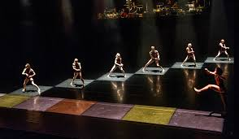
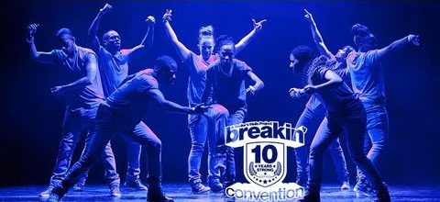
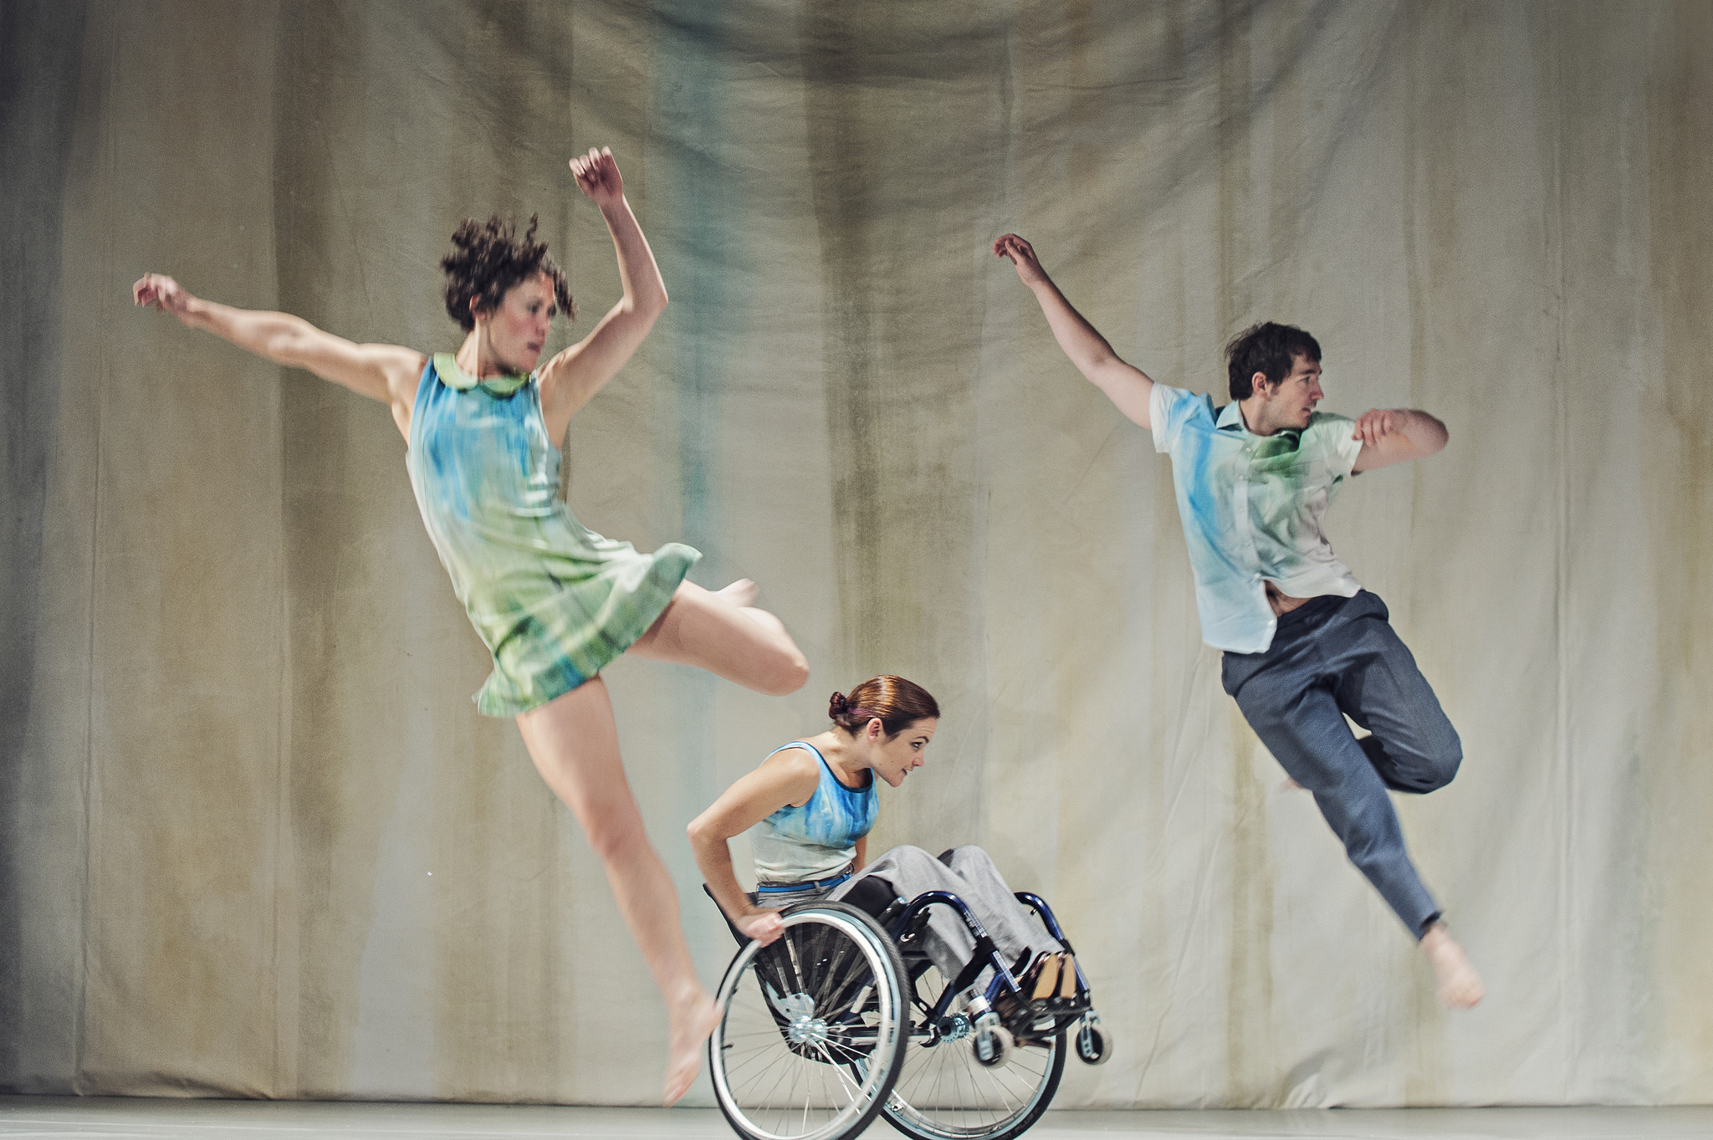
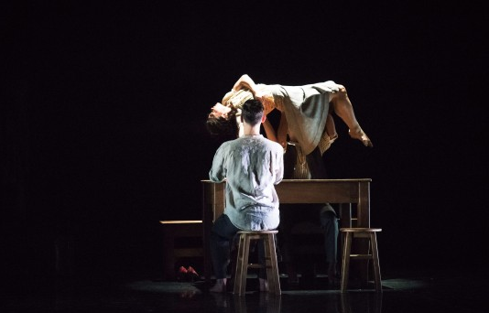
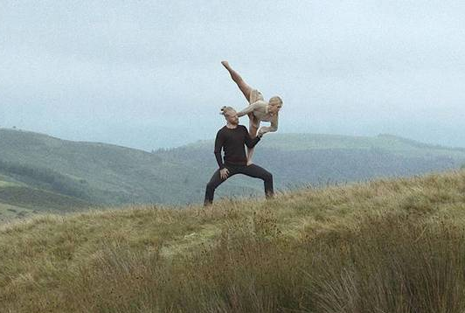
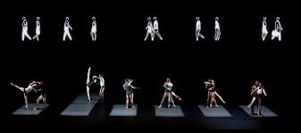
GCSE Dance
Why choose GSCE Dance?

Slide 2
You don’t have to want a job as a dancer to do GCSE Dance… but you do want all of these skills – whichever job you choose
Confidence – to present yourself in front of others
Problem Solving – working out how, why, what and when to do things
Leadership Skills - encouraging innovation and success

Slide 3
Then there is the more obvious reasons to do GCSE Dance…
Health and Fitness – 60% practical course
Literacy – description, interpretation, analysis & evaluation
Team Skills – Group Performance
Communication Skills – Choreography Tasks

Slide 4
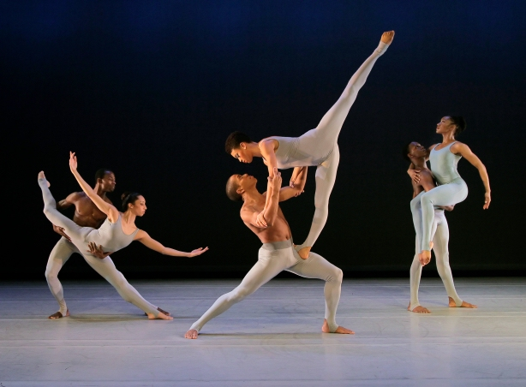
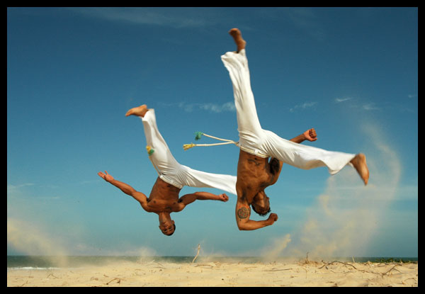
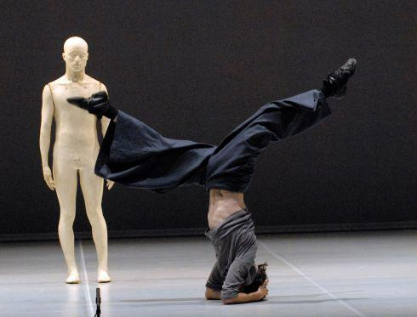
A range of Dance styles
Hip Hop
Ballet
Contemporary
Lyrical
Pedestrian
Accessible
Brazilian Samba
Site Specific

Slide 5
A creative approach to choreography 30%
Students pick from a selection of starting point that could be;
A 2D or 3D piece of Art or sculpture
Music
A Prop
Themes
Historical events
Poem or literature
Supported by a programme note for the examiner

Slide 6
Performing set phrases & Duo/TRio 30%
The AQA board have created 4 set sequences of 30-40 seconds long, students are required to;
Replicate them exactly - Action/Space/Dynamics
Perform two to be assessed as a stand alone technical exam
Include elements of two within their duo/trio

Slide 7
Developing Analytical skills 40%
As with other GCSE subjects students will be required to develop their ability to;
Analyse
Comment
Compare
Consider
Define
Evaluate
Explain
Identify
Interpret
Describe
Discuss

