Slide 1
Science Options Evening
‘Inspiring young scientists of the future, atom by atom’.
Notes:
Task

Slide 2
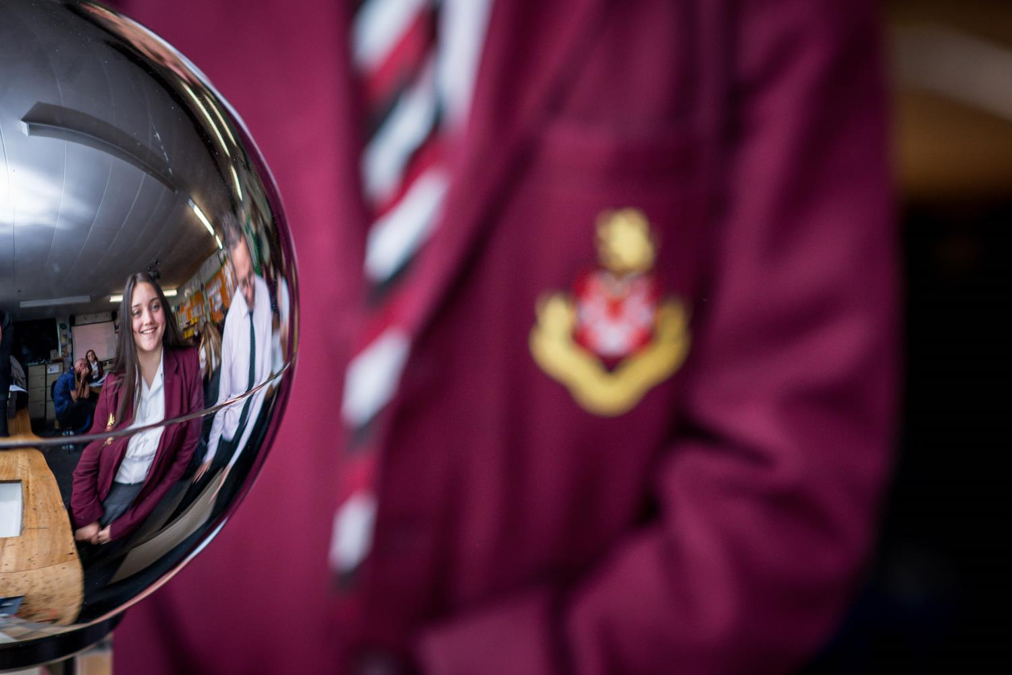
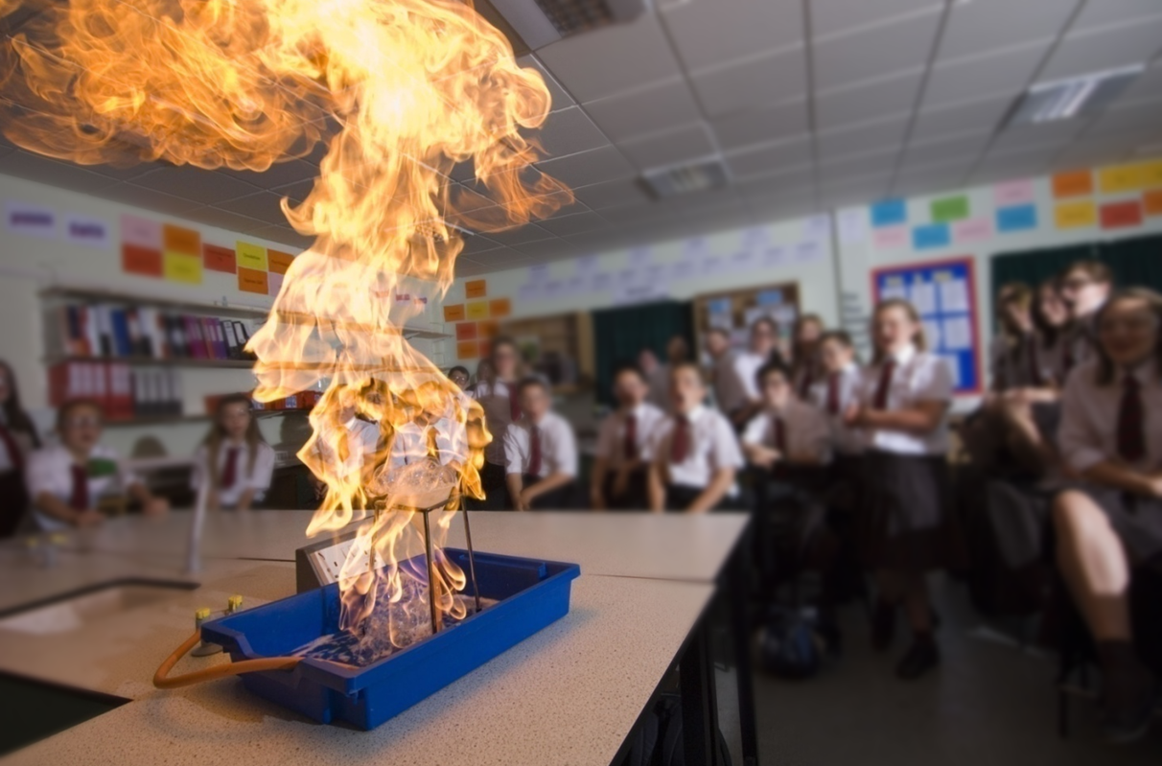
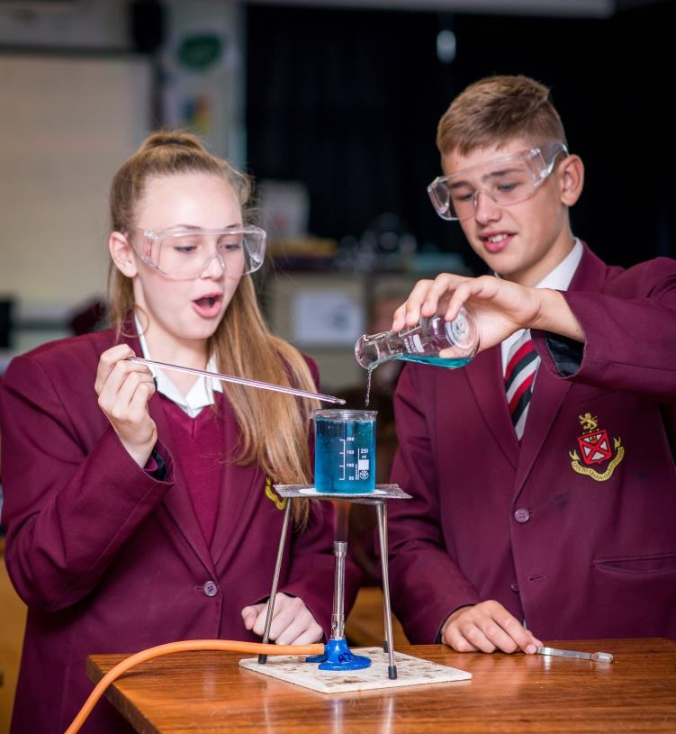
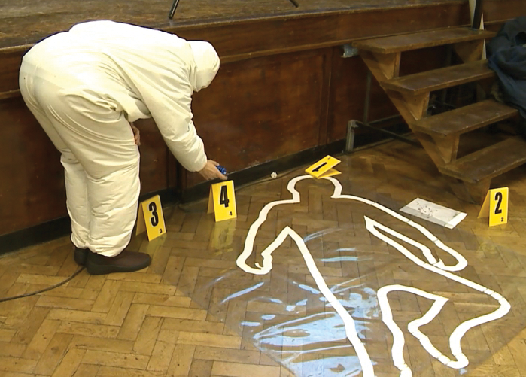

Slide 3
Why is science important?
Vision statement
‘Inspiring young scientists of the future, atom by atom’.

Slide 4
Why is science important?
Science surrounds us. It is everywhere in our daily lives - all day, every day! We want Science to inspire students to explore the world around them and recognise and understand this.

Slide 5
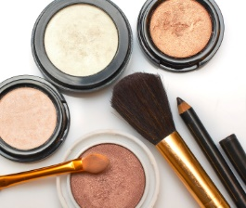
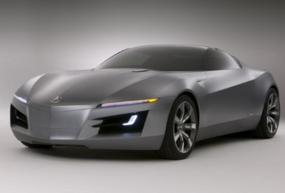
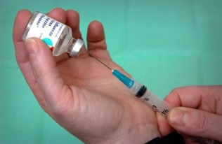
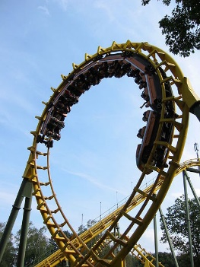
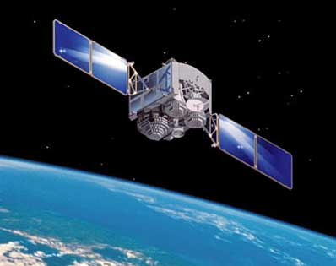
Why is science important?
Science is all around us…..
Think about all the things you used this morning to get ready.
Most of them were made or developed by scientists
How do each of these depend on science?

Slide 6
Courses
Everyone will continue with their science studies. However you have a choice of two pathways:
There are TWO pathways:
SCIENCE (2 GCSE’s)
SEPARATE SCIENCE (3 GCSE’s)
Both pathways follow the AQA exam board and specification.

Slide 7
Combined science- Trilogy
Combined science trilogy is a double award worth two GCSE’s. Students will be awarded 2 numerical GCSE Science grades based on an average of the 3 sciences e.g. 4,4 / 4,5 / 5,5.
The exam board we follow is AQA.

Slide 8
Combined science- Trilogy
You will study science for 5 hours a week.
Students will be required to sit six exam papers: two biology, two chemistry and two physics. Each of the papers will assess knowledge and understanding from distinct topic areas and are 1hour 15 mins long.
Working scientifically is assessed through purposeful practical activities (21 required practical's).
Tiers - Foundation - grades 1-5, Higher – grades 4-9. 30% of questions will be on both higher and foundation

Slide 9
Separate science- Biology, Chemistry and Physics
Students will be awarded 3 separate numerical GCSE Science grades one for each Science- Biology, Chemistry and Physics.
The exam board we follow is AQA.

Slide 10
Separate science- Biology, Chemistry and Physics
You will have 7 hours of science each week.
Students will be required to sit six exam papers: two biology, two chemistry and two physics. Each of the papers will assess knowledge and understanding from distinct topic areas and are 1hour 45 mins long.
Working scientifically is assessed through purposeful practical activities (28 required practical's- 10 Biology, 8 Chemistry and 10 Physics).
Tiers - Foundation - grades 1-5, Higher – grades 4-9. 30% of questions will be on both higher and foundation

Slide 11
Separate science- Biology, Chemistry and Physics
Separate science uses up one option block.
It is available for students following pathway 1 in the option booklet.
You will be awarded three separate GCSE’s at the end of year 11.
Separate science can lead to further study at A-level / degree.

Slide 12
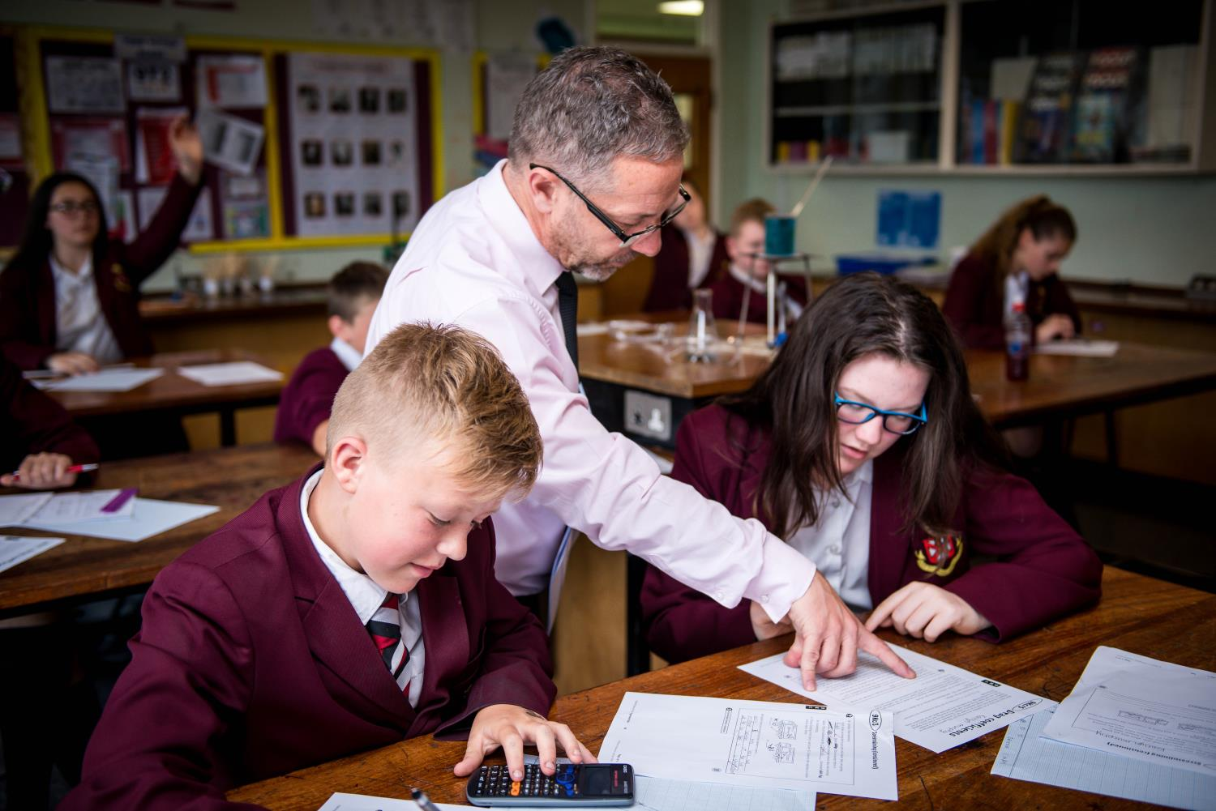
How is separate science different to combined science?
You will study the topics in more depth and an additional unit in physics.
You will be expected to do additional reading about science and keep up to date with science in the new and current developments.

Slide 13
Is separate science for me?
Are you interested in Science?
Do you work hard in Science lessons?
Are you committed to completing homework and additional work?
Do you keep up to date with science in the news?
Do you work well in a team?
Do you have good communication skills?
Can you listen to the ideas and opinions of others?

Slide 14
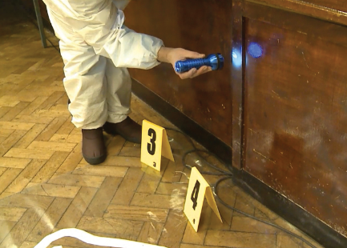
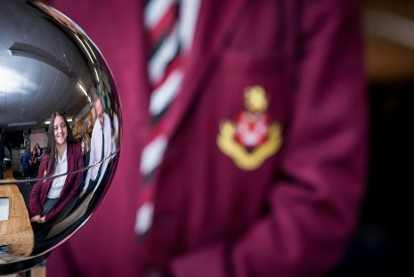
Where can I get more information?
If you require any further details you can speak to your class teacher or email them via your school email address.
Contact Katrina Millward (Head of department:
kmillward@byrchall.wigan.sch.uk

