Slide 1
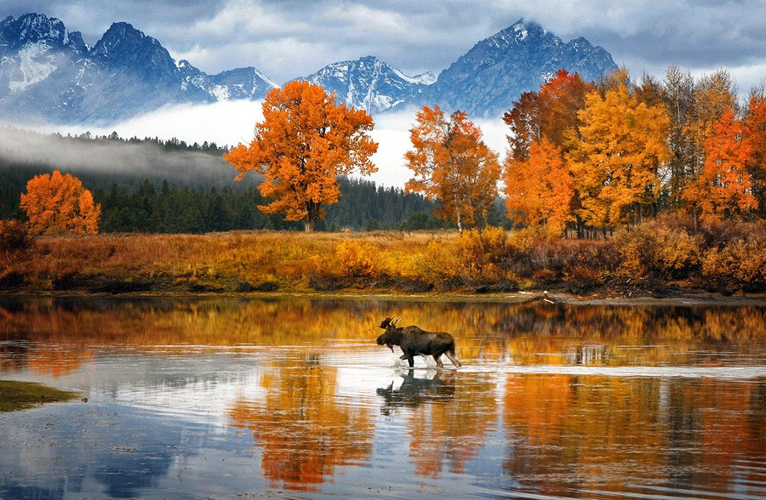
Why should I study GCSE Geography?

Slide 2
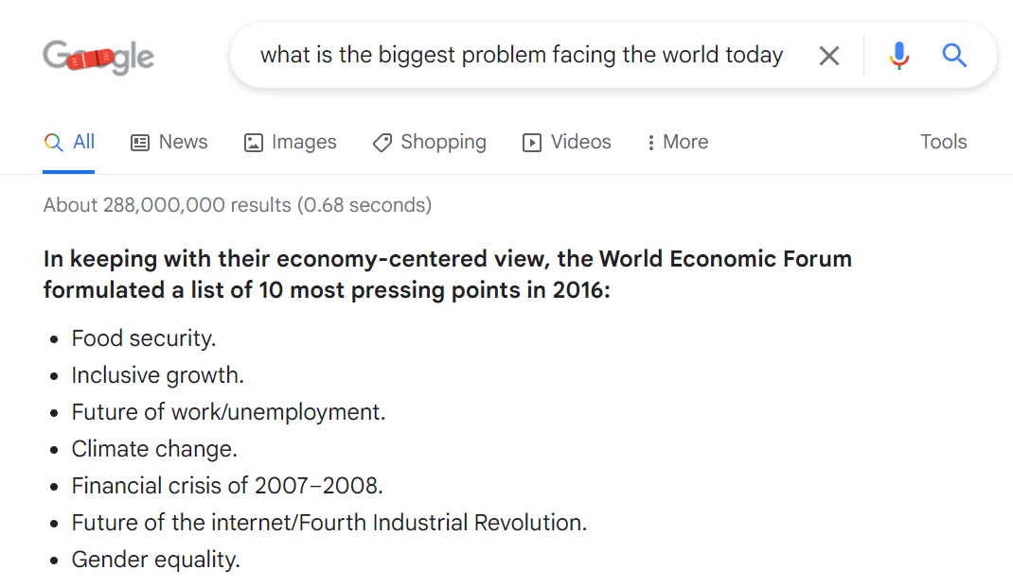
“Why do I even need Geography?”
In 2023 the World Economic Forum created a list of the most pressing points
We study all these topics at GCSE.
These are the issues facing the world today
These are the jobs of the future.

Slide 3
What does the course look like?
3 Exams
1 Human Paper (1h 30m)
1 Physical Paper (1h 30m)
1 Fieldwork Paper (1hr 30m)

Slide 4
Maths
Science
History
Geography has a little bit of every subject.
English

Slide 5
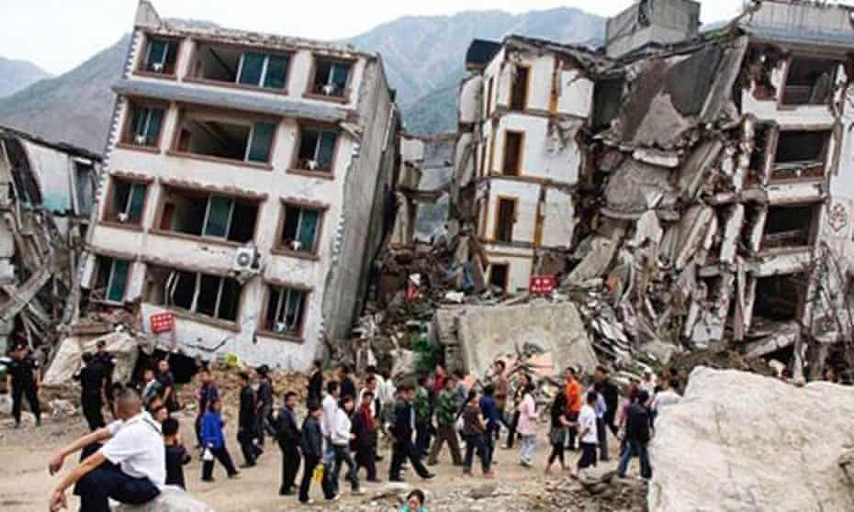
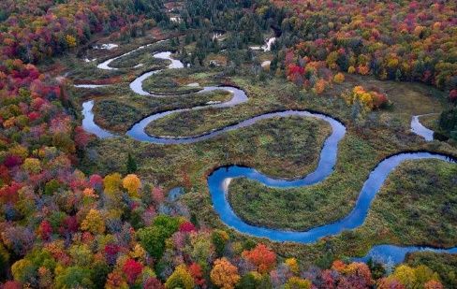
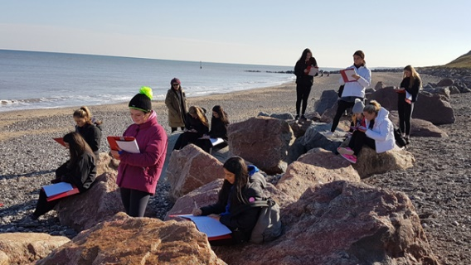
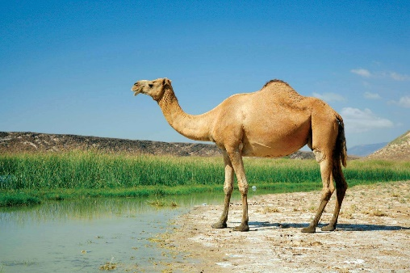
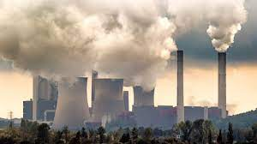
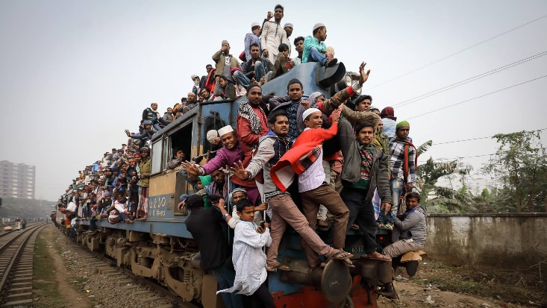
Natural Hazards:
Earthquakes
Tropical Storms
Physical Landscapes:
Rivers
Coasts
Changing Economic World
What jobs will we do in the future?
Why are some countries rich and others poor.
Fieldwork: Complete an investigation.
The Living World
Ecosystems
Rainforests
Deserts
Resource Management
Climate Change
Solar Power/Wind Power/Fossil Fuels
The Challenges of Urban Growth
- The problems of overpopulation (too many people).

Slide 6
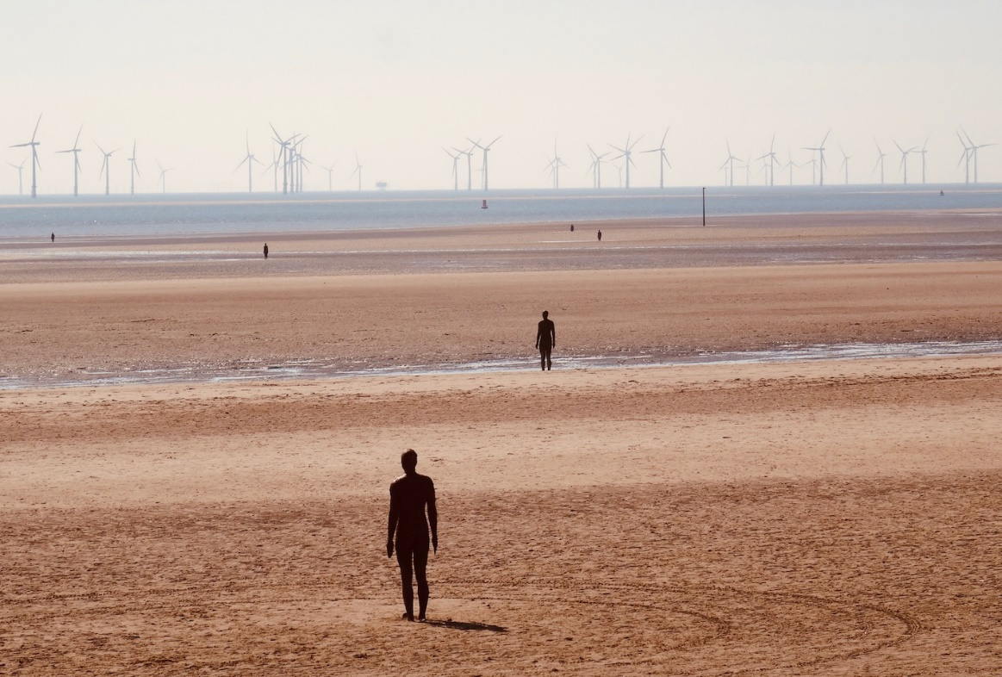
Fieldwork
You cannot get a GCSE in Geography without FIELDWORK.
That means:
You will go to at least 2 different locations outside of school
Liverpool Albert Dock
Crosby Beach

Slide 7
Can I do Geography?
Anyone with an interest in the world around them can do Geography.
Specific Skills
Good knowledge of the world, countries, continents, maps and flags!
Writing skills – we do long essay style questions (just like history!)
Decision making – you must be able to write your opinion.
Maths – we look at data in fieldwork and do calculations with the numbers.

Slide 8
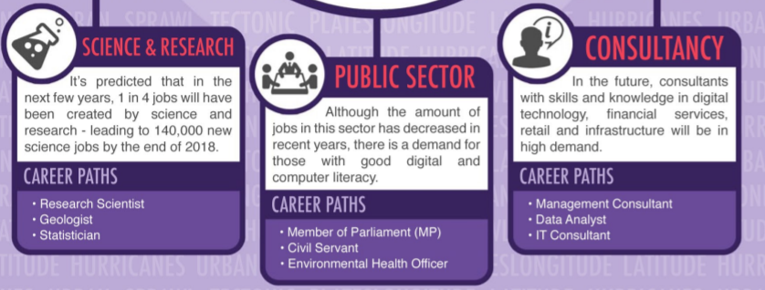
Careers in Geography

Slide 9
If you have any questions about the course come and ask in T6.

