Slide 1

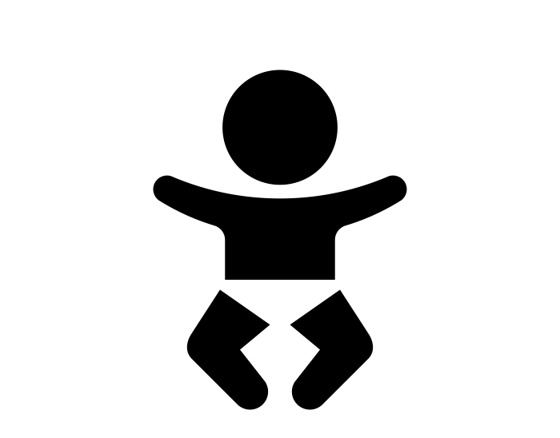




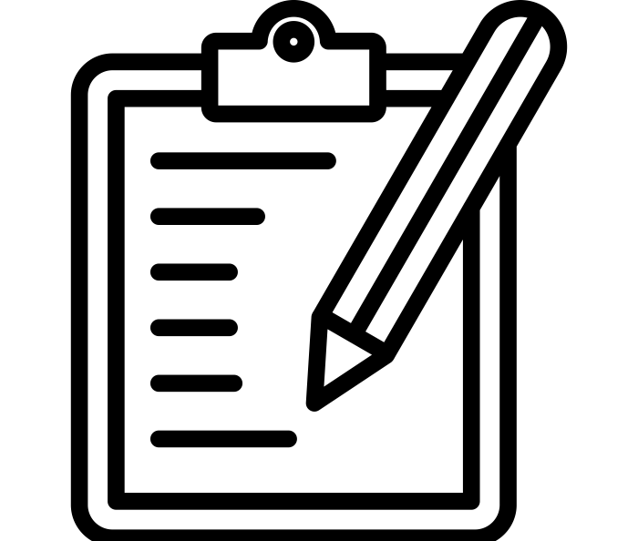



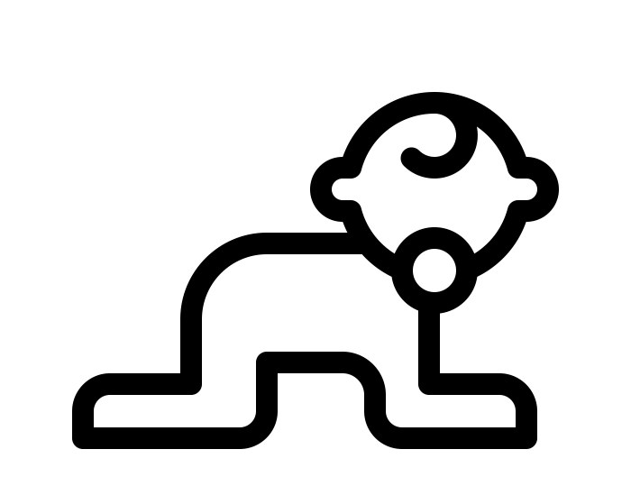
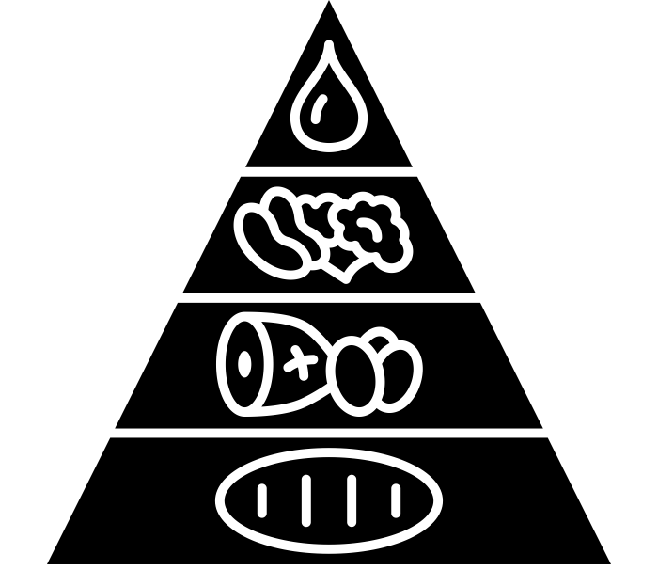

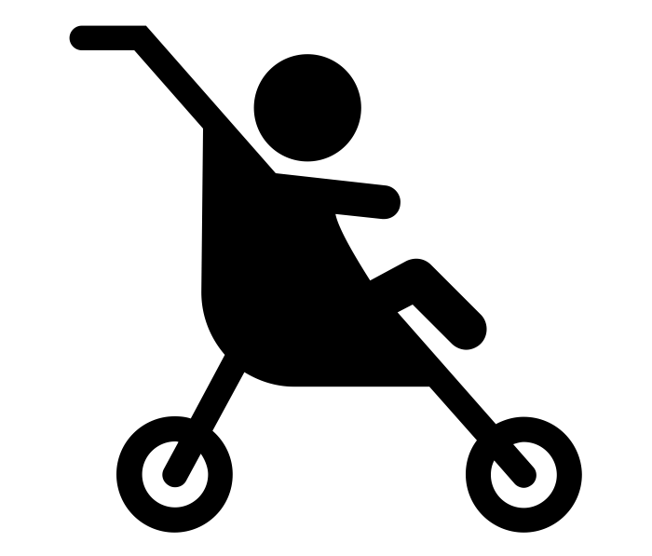
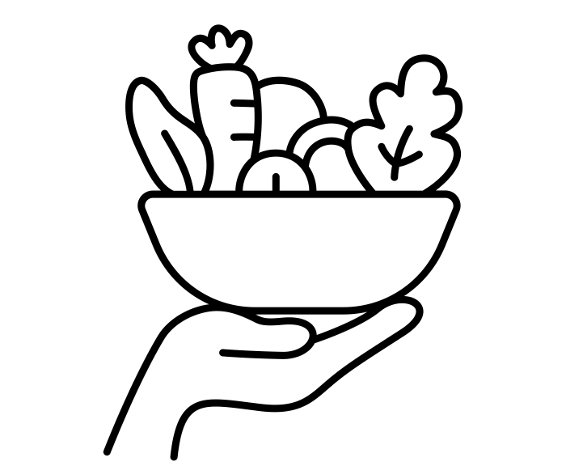
Byrchall Child Development
Course learning journey
Mock exam
Postnatal checks, care and the conditions for development
Childhood illness and a child safe environment
Externally assessed task (R057)
Internally assessed task (R059)
POST 16
Plan and evaluate lay activities
Observe the development of a child from 0-5 years
Stages of play and how play benefits development
YEAR 11
Antenatal care and preparation for birth
R059 Understand the development of a child from one to five years
Physical, intellectual and social developmental norms from 0-5 years
Preconception health and reproduction
R057 Health and well-being for child development
Internally assessed task (R058)
Nutritional needs of children 0-5 years
Key
Choosing correct equipment for 0-5 years
Investigation and developing feeding solutions 0-5 years
Unit
YEAR 10
Teaching Topic
Retrieval Opportunity
Formal Examination
R058 Create a safe environment and understand the nutritional needs of children from birth to five years
Formal assessment

